Slide 1
Changes at RPS
We are now part of the Department of Health and Human Services – Division of Health Services Regulation
STILL Radiation Protection Section
STILL at same address with same phone numbers
BUT ==== NEW E-MAIL ADDRESSES!!!
Firstname.lastname@dhhs.nc.gov

Slide 2
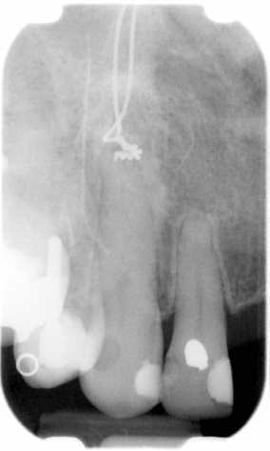
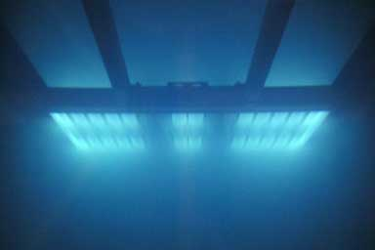
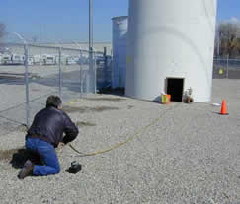
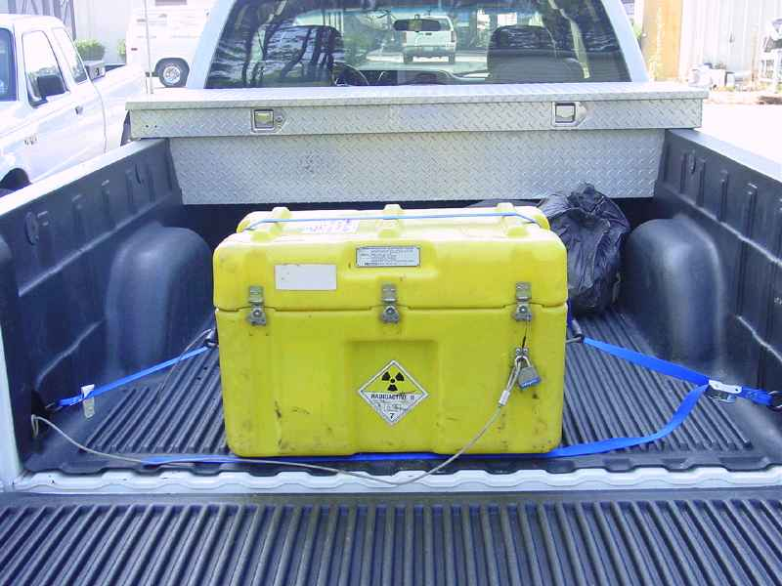
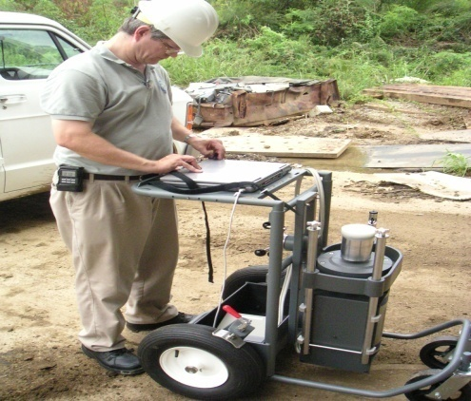
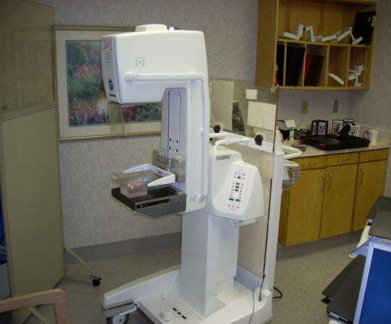
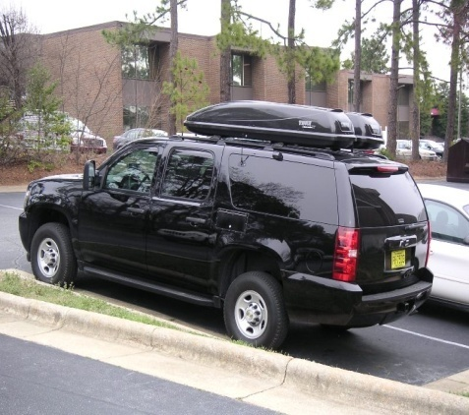
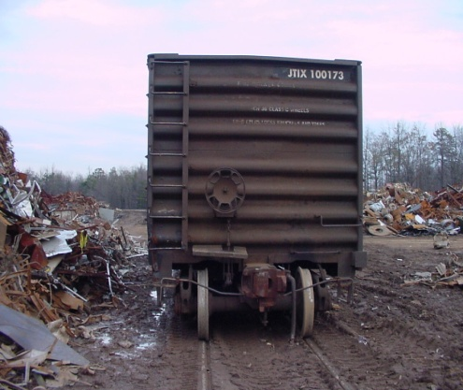
Safety Culture: Implementation and Expectations
Notes:
Give out pamphlets – Chairman Jaszko – outreach for safety culture – read it – explains philosophy

Slide 3
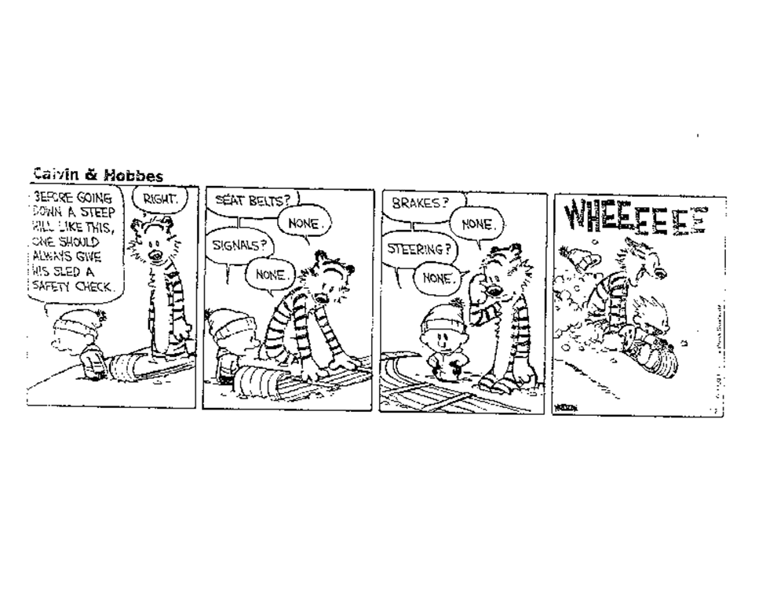
Notes:
Here’s an example of what a lot of people think safety culture is. A checklist of safety items

Slide 4
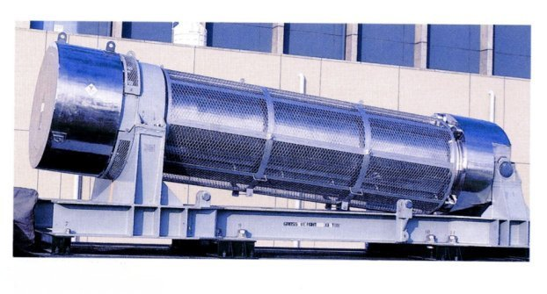
Revolves around the question:
How Safe is Safe?
Risks
Perception
Consequences
Notes:
This is a question we keep revisiting, time and time again. As demonstrated yesterday – it is a highly personal decision

Slide 5
Airline Safety
1,000,000 flight miles
5 year period from 2004 to 2009
67.5 accidents
3 fatal accidents

Slide 6
Nuclear Safety
14,400 Cumulative Reactor Years in 32 Countries
3 major accidents
2 of the 3 caused possible radiation fatalities in other countries
Only 1 major US accident and it caused no fatalities

Slide 7

So, what is Safety Culture?
Notes:
Big bang theory

Slide 8
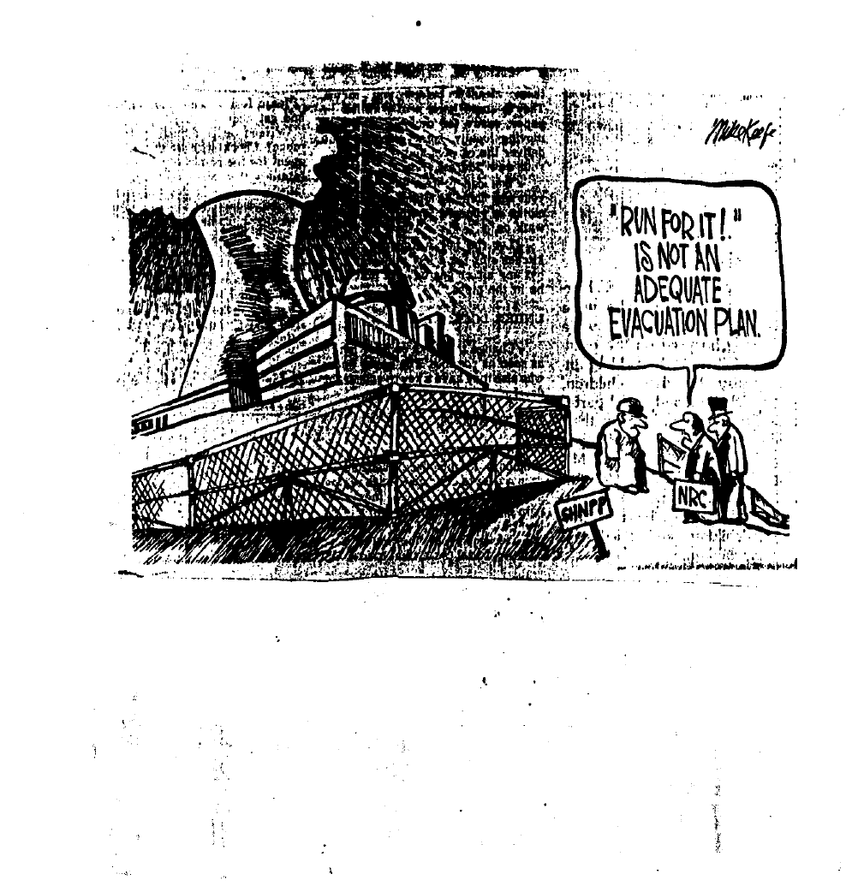
Notes:
Safety Culture requires planning – you can’t just say you have it if you have not thought about it

Slide 9
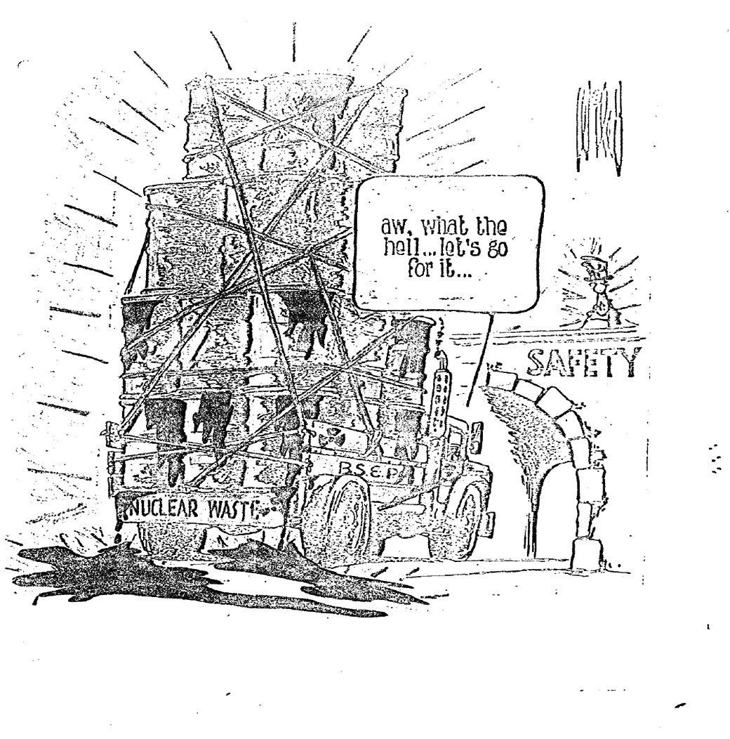
Notes:
Likewise, safety culture requires an awareness of what safety is. What it is to achieve in the real world with suboptimal conditions

Slide 10
Safety Culture is:
Organization’s core values and behaviors
Everyone’s collective commitment to safety
Emphasize safety over competing goals to ensure the protection of people and the environment
Notes:
It’s more difficult to implement that you’d think. Short term economics or corporate cultural trumps safety considerations. Safety must be first.

Slide 11
Safety Culture Traits
Personal
Leaders demonstrate a commitment to safety
Everyone takes responsibility for safety
Mutual trust and respect between everyone
Notes:
Decisions, behavior, and respect for each other are key components to safety culture

Slide 12
Safety Culture Traits
Institutional
Encourages continuous learning about safety
Safety consciousness is “blame free”
Communications focus on safety
Notes:
Problem identification and issues potentially affecting safety are identified, evaluated, and corrected promptly

Slide 13
Safety Culture Traits
Actionable
Questioning the work status quo is expected
Problems impacting safety are dealt with
Process planning and control promote safety
Notes:
Questioning means not being complacent & being aware of work env and questioning processes that might cause an unsafe condition

Slide 14
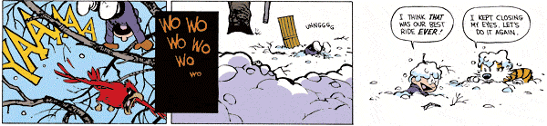
Safety Culture provides
Reasonable Assurance of Adequate Safety, Not Absolute Assurance of Perfect Safety

Slide 15
“Safety Culture is where it’s at!”
Existing Components
Licensing/Registrations/Inspections
Increased Security Controls
LTS/WBL
NMED/NSTS
Notes:
We will implement by weighing licensing & registration reviews, and root cause analysis for noncompliance, against safety culture traits

Slide 16
Support of the Policy
It is a given – being implemented
Development requires Root Cause analysis backfit (preemptive déjà vu)
Involve everything and everyone
Notes:
Outreach to licensees as it is applied to licensing, registrations and inspections, incident response. Next to the last slide!

Slide 17
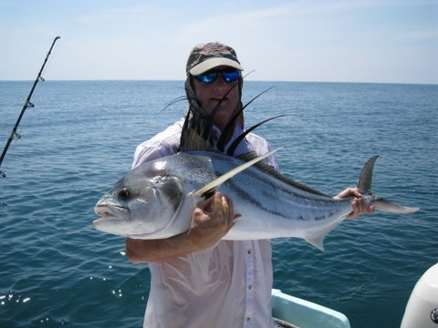
. . . and of course, it’s all about . . .
Notes:
So at the end of the day, we can all go fishing

